Slide 1
Lecture 1 Course overview

Slide 2
Things to do today
Faculty Introduction
Course Introduction
Student Introduction
Classroom and school policies
Leveling of Expectations
First Chapter lecture
Laboratory Exercise

Slide 3
My Background
Name: Dr. Caesar Clemente
B.S in Computer Science
MBA in Computer Management
MIS in Assurance Management
Ph.D. in Management
Worked as a programmer
More than 10 years in the Academe

Slide 4
Introduce yourself
Your name
Your personal background (optional)
Your IT background
Your expectations about the course

Slide 5
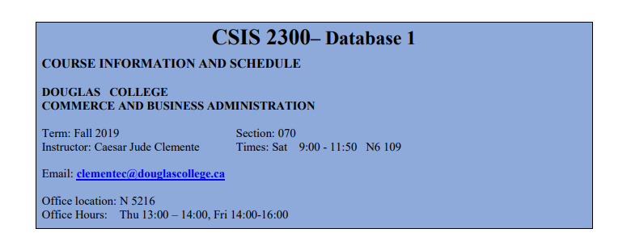
Course syllabus
Notes:
My name is …. And I will be your instructor for this semester
I know Excel and have been using it for my research and statistical analysis. But I can not say that I know everything about excel. I hope all of us can learn together in this class. Last month, I was still a student. Last year I was still sitting like you listening to instructor/professor. But here I am now becoming the instructor for this class. This is my first experience in teaching. So, things may be a bit shaky at the beginning. This semester will be my learning curve as an instructor. So, I hope all of us can learn together and improve our knowledge and expertise in Excel.
Please feel free to give me any feedback that you think may benefit our learning process.

Slide 6
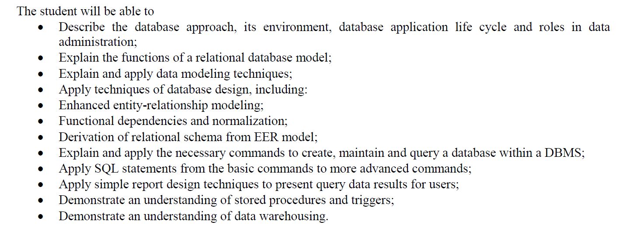
Course objectives (summary)

Slide 7
Course material
Textbook
Labs (and assignment) will be from the textbook
Exam will be based on the textbook
Course resources
Computer/laptop
USB drive (optional)
Binder to keep your notes (optional)
Blackboard Community access (mandatory)

Slide 8
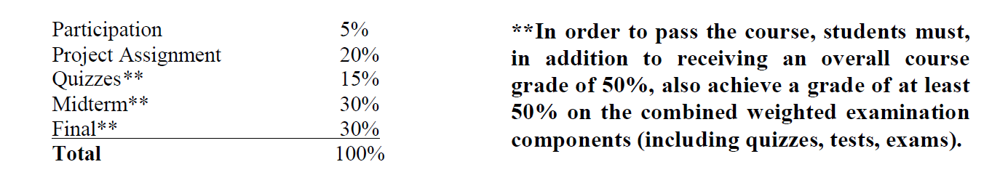
Course evaluation
You will get UN mark if:
You missed the exams, or
You missed more than 30% of the class

Slide 9

Textbook

Slide 10
Regulations
All announcements, assignments, and resources will be provided in the Blackboard
Emailing your instructor: clementec@douglascollege.ca
Subject: “CSIS2300” and a subject (absent from class, missed assignment, etc.)
In case of absent, an original signed doctors note, on official letterhead with contact information including address, phone number, email address and Physician ID is required
Office hours is not for a make up class
Late policy: after due warning, students who repeatedly late for the class may be prohibited to enter the class and will miss the attendance

Slide 11
Regulations
Late assignment will not be accepted
Missed quizzes or exams will not be made up
Unavoidable circumstances
email the instructor at your earliest opportunity
Mobile phone, internet and social media are disruptive
Other regulations in the course outline

Slide 12
Douglas college regulation
Douglas college policy, http://www.douglascollege.ca/about-douglas/governance/policies
Academic integrity
Zero tolerance for plagiarism and cheating
Violator will be:
Reported to the Dean’s office → warnings from the dean’s office may lead to failure in the course
Receive zero mark on the particular work

Slide 13
Copying other students’ work
Submitted work (exam or assignment) that is similar in style as in other program(s) submitted by another student(s) in the same or previous semesters will be considered as cheating
College policy on academic dishonesty will be applied

Slide 14
Copying other students’ work
Person’s digital signature is searchable by employers (and the Federal Government of Canada).
Think about it.
#It’sNotWorthIt

Slide 15
Project
Database project with a maximum of two students per group
Progress report of the project is due at each assignment’s deadline (assign. 1-3)
Project instruction document will be uploaded on the Blackboard next week

Slide 16
Course overview
Database Fundamentals
The relational model
SQL
Data Modeling
Database Design
Database Administration
Database Processing Applications
Big Data, Data Warehouses, and Business Intelligence Systems

Slide 17
Final Exam
All material covered in the course
FINAL Exam period: Dec. 12th – Aug. 19th
DO NOT make any travel arrangements until the final exam date is set by the College

Slide 18
Subject Expectations
Is the subject difficult?
Can I study for the subject two days before the exam?
Should I come to the class as often as possible?
What is instructor educational philosophy in teaching the class? LEARNING BY DOING

